Slide 1
Flood Exposure of Buildings and Critical Facilities: Mount Albert, Mount Roskill and Sandringham.
Ghazi Zabalawi
11/11/2026.

Slide 2
One in seven buildings sits within the 1% AEP flood plain
3,284 of 22,772 (14.4%)
Buildings intersecting the modelled flood plain, out of all buildings in Mount Albert, Mount Roskill and Sandringham
Notes:
1 in every seven buildings in these 3 suburbs (mt roskill, mt albert, and Sandringham) all intersect within flood plains, the total amount of buildings being exposed is precisely 3284 which represent a total of 14.4% out of all buildings within these suburbs.

Slide 3
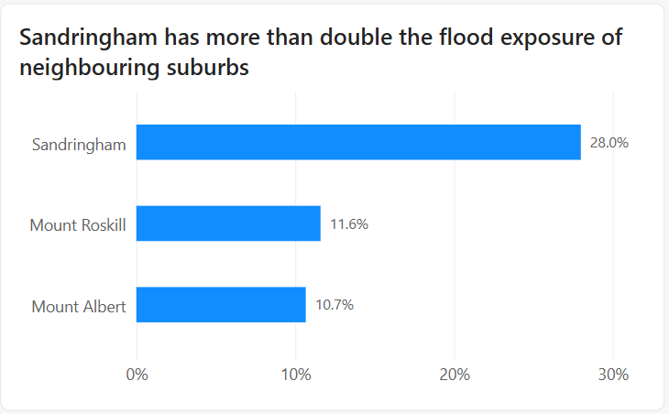
Sandringham has more than double the exposure of its neighbours
None of Sandringham’s exposed buildings are schools or supermarkets.
Notes:
Sandringham has the highest share of exposed buildings: 28% of its own buildings intersect the flood plain, more than double Mount Roskill and Mount Albert. But none of those exposed buildings are schools or supermarkets.

Slide 4
Critical-facility exposure is concentrated in Mount Roskill
34 school buildings across 5 schools
20 at Mt Roskill Grammar
4 of 7 supermarket buildings exposed in study area
Notes:
34 school buildings across 5 schools are exposed in Mount Roskill, 20 of them at Mt Roskill Grammar. Across the whole study area, 4 of the 7 supermarket buildings are also exposed, two in Mount Roskill and two in Mount Albert.

Slide 5
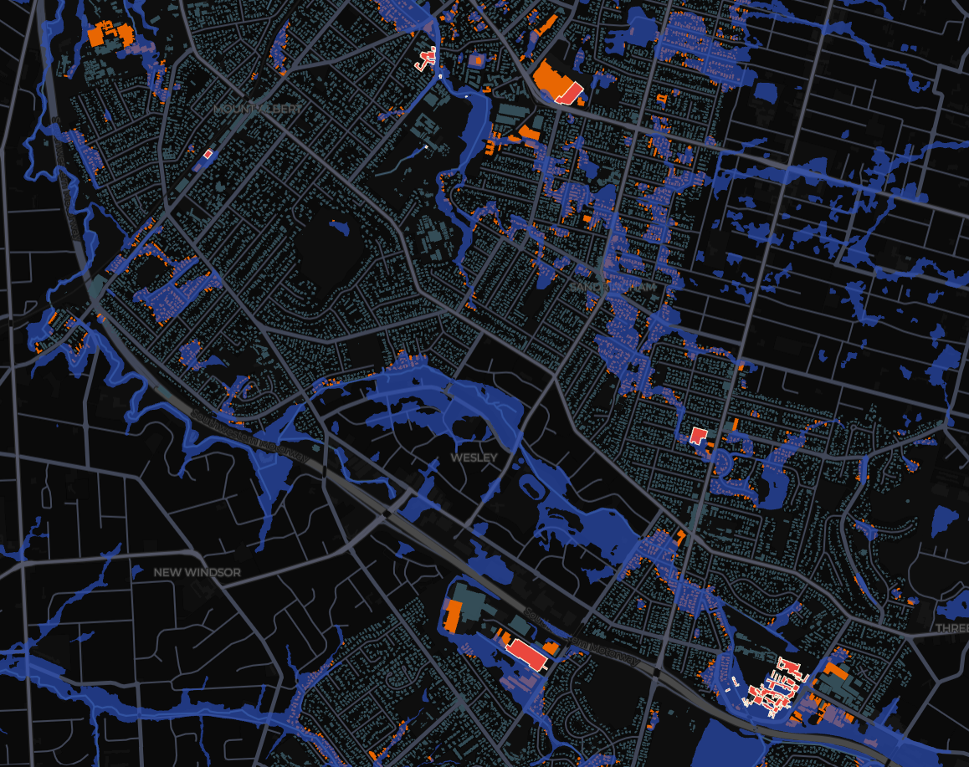
Exposed buildings follow the creek corridors
                blue = flood plain
                orange = exposed buildings
                red = schools and supermarkets
Notes:
Orange buildings are exposed and red ones are schools and supermarkets. Exposure follows the creeks rather than being spread evenly, which is why Sandringham, with a creek running through it, scores highest.

Slide 6
What this does and doesn’t tell us
Limits: exposure isn’t flooding; any overlap counts; 2017 building data; most building uses unrecorded
Next steps: flood depth, floor levels at Mt Roskill Grammar and Waikowhai, more facility types, rerun with current data
Notes:
Further research need to be done on the flooding depth, also having more accurate exposure study of floods on buildings, since exposure doesn’t always mean flooding. LINZ database only labels schools, hospitals and supermarkets, so other facilities like aged care aren’t picked up. There are no hospitals in these three suburbs.

Slide 7
THANK YOU
Notes:
Any questions?

